Slide 1
HTML Forms

Slide 2
What are forms?
<form> is just another kind of HTML tag
HTML forms are used to create (rather primitive) GUIs on Web pages
  Usually the purpose is to ask the user for information
  The information is then sent back to the server
A form is an area that can contain form elements
  The syntax is: <form parameters> ...form elements... </form>
  Form elements include: buttons, checkboxes, text fields, radio buttons, drop-down menus, etc
    Other kinds of HTML tags can be mixed in with the form elements
  A form usually contains a Submit button to send the information in he form elements to the server
  The form’s parameters tell JavaScript how to send the information to the server (there are two different ways it could be sent)
  Forms can be used for other things, such as a GUI for simple programs

Slide 3
Forms and JavaScript
The JavaScript language can be used to make pages that “do something”
  You can use JavaScript to write complete programs, but...
  Usually you just use snippets of JavaScript here and there throughout your Web page
  JavaScript code snippets can be attached to various form elements
    For example, you might want to check that a zipcode field contains a 5-digit integer before you send that information to the server
Microsoft sometimes calls JavaScript “active scripting”
HTML forms can be used without JavaScript, and JavaScript can be used without HTML forms, but they work well together
JavaScript for HTML is covered in a separate lecture

Slide 4
The <form> tag
The <form arguments> ... </form> tag encloses form elements (and probably other HTML as well)
The arguments to form tell what to do with the user input
  action="url" (required)
    Specifies where to send the data when the Submit button is clicked
  method="get" (default)
    Form data is sent as a URL with ?form_data info appended to the end
    Can be used only if data is all ASCII and not more than 100 characters
  method="post"
    Form data is sent in the body of the URL request
    Cannot be bookmarked by most browsers
  target="target"
    Tells where to open the page sent as a result of the request
    target= _blank means open in a new window
    target= _top means use the same window

Slide 5
The <input> tag
Most, but not all, form elements use the input tag, with a type="..." argument to tell which kind of element it is
  type can be text, checkbox, radio, password, hidden, submit, reset, button, file, or image
Other common input tag arguments include:
  name: the name of the element
  value: the “value” of the element; used in different ways for different values of type
  readonly: the value cannot be changed
  disabled: the user can’t do anything with this element
  Other arguments are defined for the input tag but have meaning only for certain values of type

Slide 6
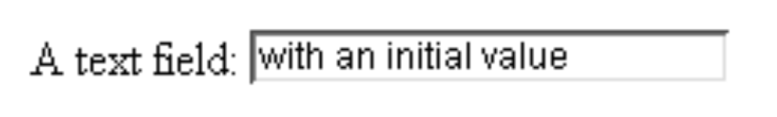
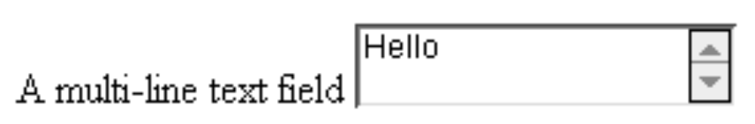
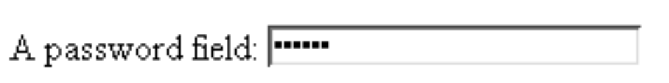
Text input
A text field:
<input type="text" name="textfield" value="with an initial value">
A multi-line text field
<textarea name="textarea" cols="24" rows="2">Hello</textarea>
A password field:
<input type="password" name="textfield3" value="secret">
• Note that two of these use the input tag, but one uses textarea

Slide 7
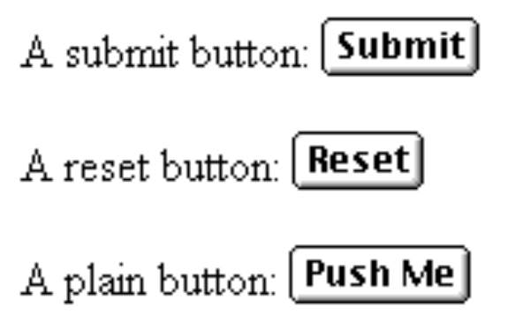
Buttons
A submit button:
<input type="submit" name="Submit" value="Submit">
A reset button:
<input type="reset" name="Submit2" value="Reset">
A plain button:
<input type="button" name="Submit3" value="Push Me">
submit: send data
reset: restore all form elements to their initial state
button: take some action as specified by JavaScript
• Note that the type is input, not “button”

Slide 8
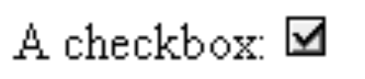
Checkboxes
A checkbox:
<input type="checkbox" name="checkbox”
value="checkbox" checked>
type: "checkbox"
name: used to reference this form element from JavaScript
value: value to be returned when element is checked
Note that there is no text associated with the checkbox—you have to supply text in the surrounding HTML

Slide 9
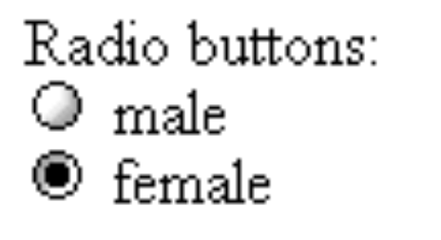
Radio buttons
Radio buttons:<br>
<input type="radio" name="radiobutton" value="myValue1">
male<br>
<input type="radio" name="radiobutton" value="myValue2" checked>
female
If two or more radio buttons have the same name, the user can only select one of them at a time
  This is how you make a radio button “group”
If you ask for the value of that name, you will get the value specified for the selected radio button
As with checkboxes, radio buttons do not contain any text

Slide 10
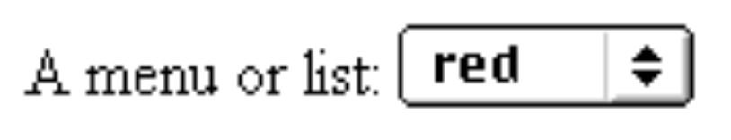
Drop-down menu or list
A menu or list:
<select name="select">
<option value="red">red</option>
<option value="green">green</option>
<option value="BLUE">blue</option>
</select>
Additional arguments:
  size: the number of items visible in the list (default is "1")
  multiple: if set to "true", any number of items may be selected (default is "false")

Slide 11
Hidden fields
<input type="hidden" name="hiddenField" value="nyah">
&lt;-- right there, don't you see it?
What good is this?
  All input fields are sent back to the server, including hidden fields
  This is a way to include information that the user doesn’t need to see (or that you don’t want her to see)
  The value of a hidden field can be set programmatically (by JavaScript) before the form is submitted

Slide 12
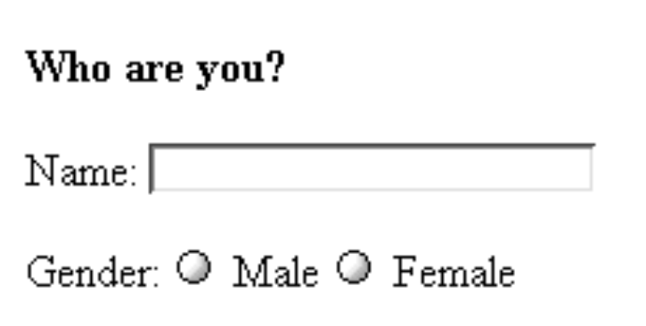
A complete example
<html>
<head>
<title>Get Identity</title>
<meta http-equiv="Content-Type" content="text/html;
charset=iso-8859-1">
</head>
<body>
<p><b>Who are you?</b></p>
<form method="post" action="">
<p>Name:
<input type="text" name="textfield">
</p>
<p>Gender:
<input type="radio" name="gender" value="m">Male
<input type="radio" name="gender" value="f">Female</p>
</form>
</body>
</html>

Slide 13
The End

